Slide 1


Special topics
Session 8
Al-Zahra university
Maryam zim
@maryamzim maryamxiim@gmail.com

Slide 2
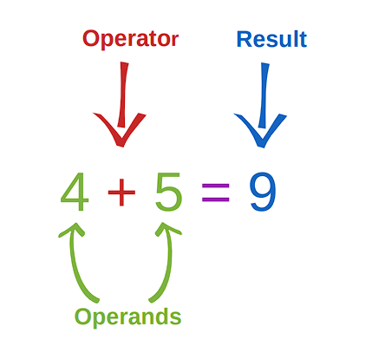
Operator :
Operators are a special symbol or keyword that tells JavaScript to perform an action on one or more operands.

Slide 3
Operator:
JavaScript has several categories of operators, categorized by the type of operation they perform:
1. Arithmetic Operators:
These operators perform basic mathematical calculations on numbers.
Operator | Description | Example | Result
+ | Addition | 5 + 3 | 8
- | Subtraction | 10 - 4 | 6
* | Multiplication | 6 * 2 | 12
/ | Division | 10 / 2 | 5
++ | Increment (adds 1) | x++ | x = x + 1
-- | Decrement (subtracts 1) | x-- | x = x - 1

Slide 4
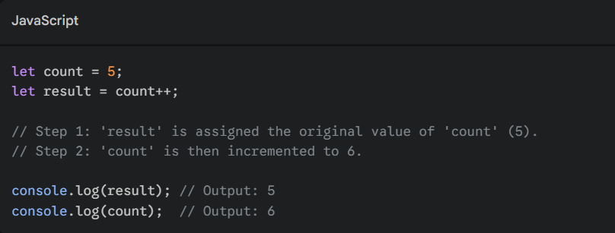
Increment (++) and Decrement (--)
Both ++ and -- are unary operators (they operate on a single operand).
++ adds 1 to the variable.
-- subtracts 1 from the variable.
The difference appears when these operators are used within a larger expression that returns a value.
Postfix Operators (x++ or x--)
In postfix form, the operator comes after the variable (e.g., x++).
Timing: The variable is incremented/decremented after the value of the expression is returned.
Return Value: The expression evaluates to the variable's original value (before the change).

Slide 5
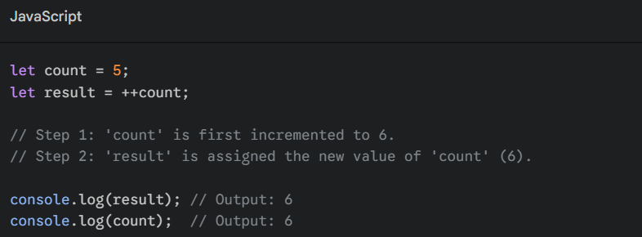
Prefix Operators (++x or --x)
In prefix form, the operator comes before the variable (e.g., ++x).
Timing: The variable is incremented/decremented before the value of the expression is returned.
Return Value: The expression evaluates to the variable's new value (after the change).

Slide 6
Soooooooo: 🤯
Feature | Postfix (x++) | Prefix (++x)
Operation Position | After the variable | Before the variable
Variable Change | Happens after the expression returns | Happens before the expression returns
Value Returned | The original value | The new value

Slide 7
Operator:
2. Assignment Operators:
These operators are used to assign a value to a variable. The most common is the simple assignment operator (=).
Operator | Description | Example | Equivalent to...
= | Assigns the value on the right to the variable on the left. | let x = 10; | -
+= | Addition assignment. | x += 5; | x = x + 5;
-= | Subtraction assignment. | x -= 2; | x = x - 2;
*= | Multiplication assignment. | x *= 3; | x = x * 3;
/= | Division assignment. | x /= 2; | x = x / 2;

Slide 8
Operator:
3. Comparison Operators
These operators compare two operands and return a Boolean value (true or false). They are essential for control flow structures like if statements.
Operator | Description | Example | Result
== | Equal to (checks value, but ignores type - avoided in modern JS). | 5 == "5" | true
=== | Strict Equal (checks both value AND type - preferred). | 5 === "5" | false
!= | Not equal to (ignores type). | 5 != 6 | true
!== | Strict Not Equal (checks both value AND type - preferred). | 5 !== "5" | true
> | Greater than | 7 > 3 | true
< | Less than | 2 < 8 | true
>= | Greater than or equal to | 4 >= 4 | true
<= | Less than or equal to | 5 <= 1 | false

Slide 9
Before we know about last operator(logical operator) we should know about truthy and falsy in javascript :
So
What is truthy and falsy ?
Truthy and Falsy are concepts in JavaScript that define how values—even non-Boolean values like numbers and strings—are treated when evaluated in a Boolean context.
This evaluation happens automatically in control flow statements, such as if conditions, while loops, or when using logical operators like && or ||.
1. Falsy Values
A Falsy value is a value that is considered false when encountered in a Boolean context.
There are only six values in JavaScript that are inherently falsy. Every other value is truthy.
Please look at next page 👀

Slide 10
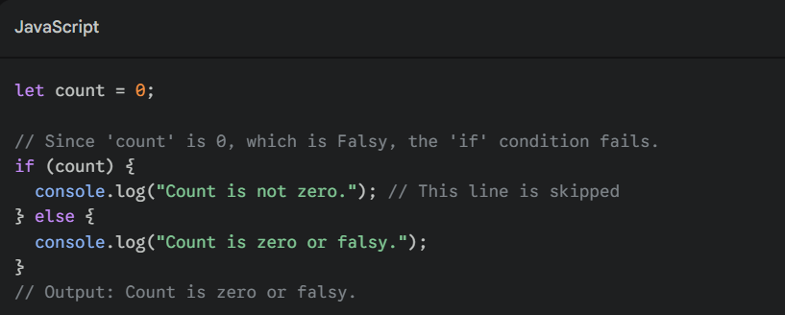
1. Falsy Values:
Falsy Value | Data Type | Description
false | Boolean | The Boolean value itself.
0 | number | The number zero.
"" | string | An empty string (zero length).
null | object | Represents the intentional absence of an object value.
undefined | undefined | A variable that has been declared but not assigned a value.
NaN | number | Stands for "Not a Number" (e.g., the result of 0/0).

Slide 11
What is truthy and falsy ?
1. Truthy Values
A Truthy value is any value that is considered true when encountered in a Boolean context.
If a value is not one of the six falsy values listed above, it is truthy.
Truthy Value | Description | Examples
All objects | Including arrays and functions. | {}, [], function() {}
Non-empty strings | Any string with one or more characters, including strings containing only whitespace or "0". | "hello", "(space)", "0"
Non-zero numbers | Any positive or negative number, including fractions. | 1, -5, 3.14

Slide 12
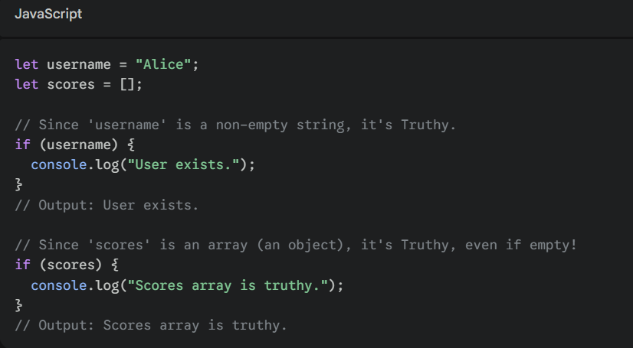
Example Truthy :

Slide 13
Operator:
4. Logical Operators:
These operators are used to combine or manipulate Boolean values, often combining the results of comparison operations.
Operator | Description | Example | Result
&& | AND: Returns true if both operands are true. | (x > 0) && (y < 10) | true or false
|| | OR: Returns true if at least one operand is true. | (x > 0) || (y < 10) | true or false
! | NOT: Reverses the logical state. | !true | false
NOTE:
The !! operator in JavaScript is a shorthand way to explicitly convert any value into its corresponding Boolean equivalent (true or false).

Slide 14
Logical AND (&&):
The && operator requires both operands to be true for the expression to evaluate to true. If even one operand is false, the entire expression is false.
Expression | Result | Explanation
true && true | true | Both are true.
true && false | false | The second operand is false.
false && true | false | The first operand is false.
false && false | false | Both are false.

Slide 15
Logical OR (||):
The || operator requires only one operand to be true for the expression to evaluate to true. It only evaluates to false if both operands are false.
Expression | Result | Explanation
True || True | true | Both are true.
False || False | false | Both are false.
True || False | true | The first operand is true.
False || True | true | The second operand is true.

Slide 16
Operator Precedence:
Operators | Description | Example | Result
() | Grouping (always executed first) | 2 * (3 + 1) | 8
++, -- | Unary Increment/Decrement | x++ | -
*, / | Multiplication, Division | 10 + 2 * 3 | 16 (2*3 is done first)
+, - | Addition, Subtraction | 5 - 3 + 1 | 3 (Left-to-right)
<=, >=, <, > | Comparison | x > y | -
== , === , != , !== | Comparison | x == y
&& | Logical AND | true && false | false
|| | Logical Or | True || false | true
=, +=, -= | Assignment | x = 5 | -

Slide 17
Conditional:
A conditional in JavaScript is a programming structure that allows you to execute different blocks of code based on whether a specified condition evaluates to true or false.
Key Conditional Structures
JavaScript provides main ways to implement conditional logic:
1. if...else if...else Statement
This is the most common way to execute code based on one or more conditions.
if: The code block inside the if statement is executed only if its condition is true.
else if: (Optional) Used to check a second condition if the preceding if condition was false. You can have multiple else if blocks.
else: (Optional) The code block inside the else statement is executed if all preceding if and else if conditions were false.

Slide 18
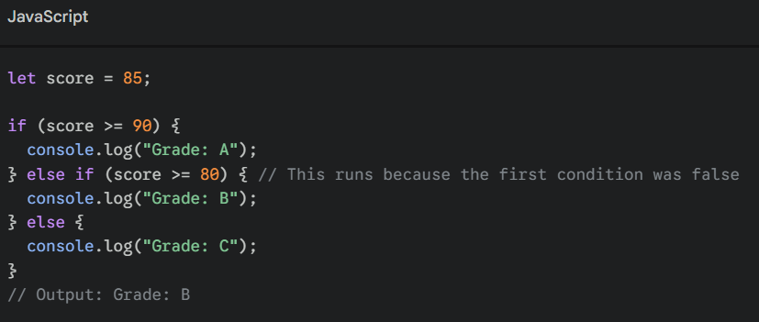
Example if...else if...else Statement:

Slide 19
Conditional:
2. switch Statement:
The switch statement is used to perform different actions based on different possible values of a single expression. It's often cleaner than using a long series of else if statements to check the exact value of one variable.
case: A block of code to execute if the expression matches the case value.
break: Crucially, the break keyword stops the execution inside the switch block once a match is found.
default: (Optional) The code to execute if none of the case values match the expression.

Slide 20
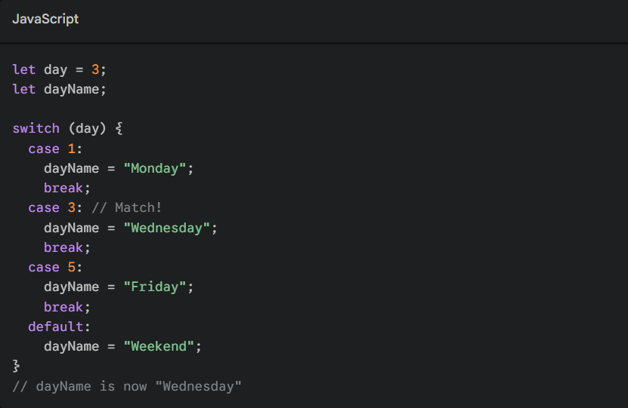
Example switch:

